Slide 1

Fitness Tracker Application Workflows
A hypothetical software development project for a Fitness Tracker App that integrates wearable device data, workout tracking, and user analytics. This repository documents the project's flowcharts, architecture, and development lifecycle.
AD400 Winter – 2025
Biruk B

Slide 2
Basic Flow Chart (SDLC Overview)
1. Basic Flow Chart (SDLC Overview)
Purpose: Visualize the high-level software development lifecycle (SDLC) for the Fitness Tracker App.
Fitness App Example:
Requirement Gathering: Define features (step tracking, heart rate monitoring).
Design: Create UI mockups for workout dashboard.
Development: Code integration with wearable devices.
Testing: Validate calorie calculation accuracy.
Deployment: Release on iOS/Android app stores.
Key Insight
Linear flow highlights major phases but does not show iterative feedback loops (e.g., post-deployment user feedback).
Start
Requirement Gathering
Design
Development
No
Testing
Yes
Deployment
End

Slide 3
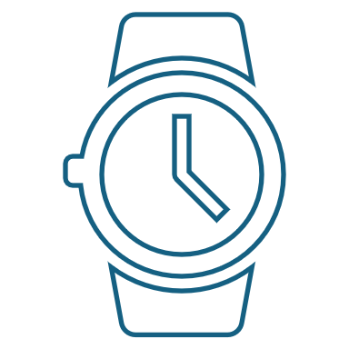
System Flow Chart (App Architecture)
2. System Flow Chart (App Architecture)
Purpose: Illustrate interactions between system components.
Fitness App Example:
API Gateway: Handles requests from the app (e.g., fetching workout history).
External APIs: Integrate with Google Fit/Apple HealthKit for data syncing.
Key Insight
The API Gateway is a potential bottleneck; consider load balancing for scalability.
Start
User Interface (Mobile App)
API Gateway
Backend Server
Database
Sync Data
Wearable Device (FitTrack)

Slide 4
Workflow Diagram (Feature Development)
Start
3. Workflow Diagram (Feature Development)
Purpose: Map roles and tasks for developing a feature (Workout Tracking).
Swimlanes: Roles (Product Manager, Designer, Developer, QA, DevOps)
Product Manager: [Gather User Stories] → [Approve Requirements]
Designer: [Create Wireframes] → [Handoff to Developer]
Developer] Developer: [Implement Feature] → [Submit for Testing]
QA Engineer: [Test Feature] → [Report Bugs] (if any) → [Re-test]
DevOps Engineer: [Deploy to Staging] → [Monitor Post-Launch]
Key Insight
Delays in wireframe approval can block development; use collaborative tools like Figma for real-time feedback.
Product Manager
Gather User Stories
Approve Requirements
Designer
Create Wireframes
Handoff to Developer
Developer
Gather User Stories
Approve Requirements
QA Engineer
[Test Feature] → Report Bugs] (if any) → [Re-Test]
DevOps Engineer
[Deploy to Staging] → [Monitor Post-Launch]

Slide 5
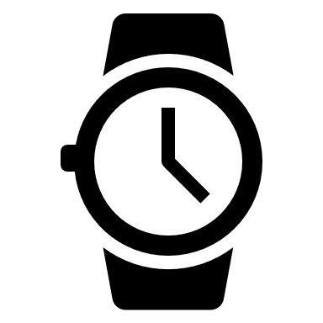



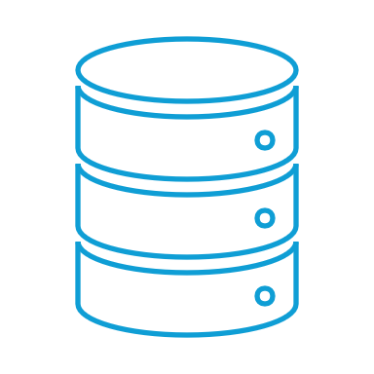
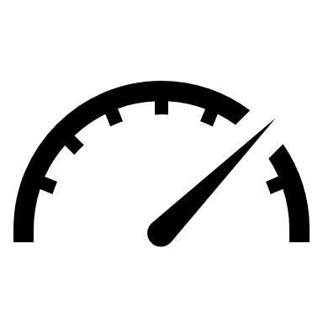
Data Flow Chart (Fitness Data Journey)
Start
4. Workflow Diagram (Feature Development)
Purpose: Track how fitness data moves through the system.
Flow:
[Wearable Device (Steps/HR Data)] →
[Mobile App] →
[API Gateway] →
[Backend Server] →
[Database (User Profile)] →
[Analytics Dashboard (Calories Burned Insights)]
Key Insight
Data encryption is critical at the API Gateway to protect user health information.
Wearable Device Steps/HR Data
Mobile App
API Gateway
BackendServer
Database (User Profile)
Analytics Dashboard (Calories Burned Insights)

Slide 6
Decision Flow Chart (User Interaction Logic)
5. Decision Flow Chart (User Interaction Logic)
Purpose: Model conditional logic for app features.
Flow:
[Start] → [User Opens App] → [Has Fitness Goal?]
→ Yes → [Recommend Workout Plan] → [Track Progress] → [End]
→ No → [Prompt to Set Goal] → [End]
Key Insight
Clear error messages improve user experience (e.g., "Enable Bluetooth to sync").
Start
User Opens App
Have Fitness Goal?
Yes
No
Recommend Workout Plan
Prompt to Set Goal
Branch Example (Error Handling)
[Sync Wearable Data] → [Is Device Connected?]
→ Yes → [Update Dashboard]
→ No → [Show Error: "Connect Device]
Track Progress
End
End

Slide 7
Swimlane Flow Chart (Cross-Team Collaboration)
6. Swimlane Flow Chart (Cross-Team Collaboration)
Purpose: Visualize handoffs between departments.
Swimlanes: Teams (Product, Design, Development, QA, DevOps)
Flow:
Product Team: [Define "Sleep Tracking" Feature] → [Handoff to Design]
Design Team: [Create Sleep UI Mockups] → [Handoff to Development]
Development Team: [Code Sleep Analysis Algorithm] → [Handoff to QA]
QA Team: [Test Sleep Data Accuracy] → [Handoff to DevOps]
DevOps Team: [Deploy to Production] → [Monitor Performance]
Key Insight
Clear error messages improve user experience (e.g., "Enable Bluetooth to sync").
Start
User Opens App
Analytics Dashboard (Calories Burned Insights)
User Opens App
Analytics Dashboard (Calories Burned Insights)
User Opens App
Analytics Dashboard (Calories Burned Insights)
User Opens App
Analytics Dashboard (Calories Burned Insights)
User Opens App
Analytics Dashboard (Calories Burned Insights)

